Slide 1

MATH24 Differential Equations

Slide 2
Equations with Homogeneous Coefficients
The differential equation M(x, y)dx + N(x, y)dy is homogeneous if both M and N are homogeneous and are of the same degree.
Theorem:
If M(x, y) and N(x, y) are both homogeneous and of the same degree, the function or N/M is of degree 0.
If f(x, y) is homogeneous of degree zero in x + y, then f(x, y) is a function of y/x alone.

Slide 3
General Solution of A Homogeneous D. E.
If M(x, y) and N(x, y) are homogeneous and of degree zero, then the ratio M/N of N/M can be expressed as a function of single variable alone, say v.
Thus, the substitution x = vy or y = vx will transform the equation to a variable separable D. E.
Note: A differential equation is homogeneous if all the terms are of the same degree.

Slide 4
Examples
Test for homogeneity.
(x² + y²)dx + xydy = 0
M = x² + y², homogeneous of degree 2
N = xy, homogeneous of degree 2
Thereforem, the D. E. is homogeneous.
(3x + 2y)dx – (x² + 2xy + y²)dy = 0
M = 3x + 2y, homogeneous of degree 1
N = x² + 2xy + y², homogeneous of degree 2.

Slide 5



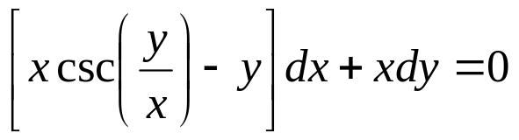

Examples
Test whether each equation is homogeneous or not. If it is homogeneous then find the general solution.

Slide 6
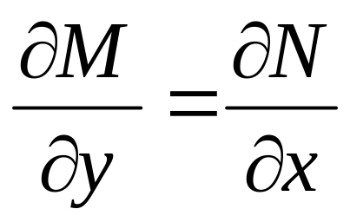
Exact Differential Equation
Consider the General Form of D. E.: M(x, y) + N(x, y)dy = 0
is a necessary and sufficient condition to be an exact equation.
Exact differential equations may be solved using any of the four methods.
Integrable combination
Partial derivatives
Line integral
Alternative solution

Slide 7

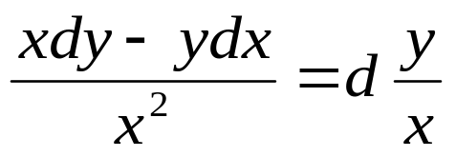
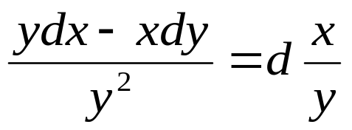
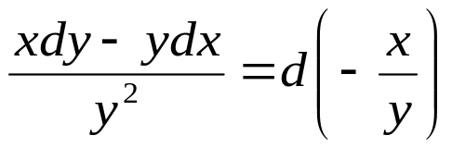
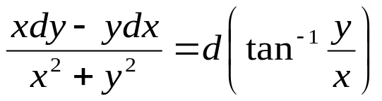
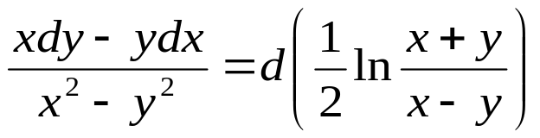
Integrable Combinations
Some integrable combinations.

Slide 8
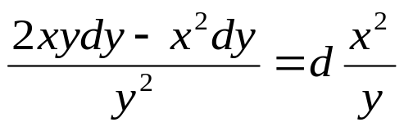
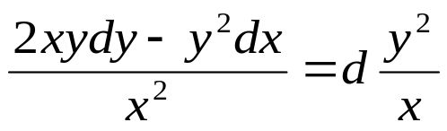

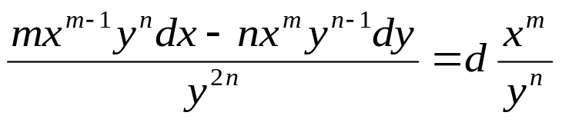
Integrable Combinations
Some integrable combinations.

Slide 9
Examples
Test the exactness and find the general solution.
(2x + 3y – 5)dx + (3x – y – 2)dy = 0
(3x²y – 6x)dx + (x³ + 2y)dy = 0
3y(x² – 1)dx + (x³ + 8y – 3x)dy = 0
(4x³y³ + 1/x)dx + (3x⁴y² – 1/y)dy = 0

Slide 10
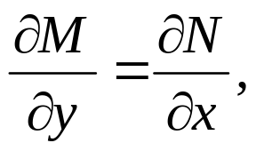
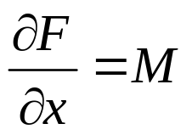
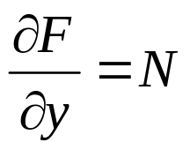

Partial Derivatives
Consider the equation: M(x, y)dx + N(x, y)dy = 0
If then (1) is an exact equation. Therefore, its solution is F = c where
Determine F from (2) by integrating both sides with respect to x, treating y as constant where the usual arbitrary constant in indefinite integration is a function T(y) which is yet
unknown. To determine T(y), obtain equate it to (3) and
integrate. This time, no arbitrary constant is needed in obtaining T(y) since one is being introduced on the right side in the solution F = c.
(2)
(3)

Slide 11
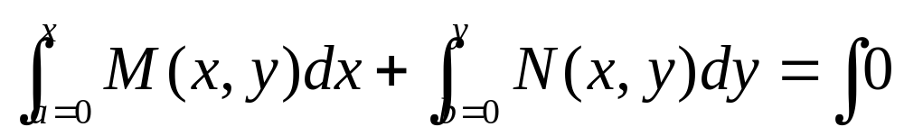
Line Integrals
Consider
where a, b = arbitrary constants for which M and N are defined.
If M and N are polynomial functions, set a = b = 0 since a polynomial function is always defined at the origin except when the functions become undefined. In this case, try substituting other values for a and b that will make the functions undefined.
Note: In the first integral, treat y as constant
In the second integral, replace x by the value of a.

Slide 12
Line Integral
This method is applicable only when M and N are either polynomial functions or transcendental functions but never a combination of polynomial and transcendental functions.

Slide 13
Alternative Solution
Consider the equation: M(x, y)dx + N(x, y)dy = 0
For M: integrate x and treat y as constant
N: integrate terms without x

Slide 14
Integrating Factor Found by Inspection (for NEDE)

Slide 15
Integrating Factor Found by Inspection (for NEDE)

